Slide 1

Silenced Symptoms: Reclaiming Women's Health
Boomers and Gen-X have been dismissed, undertreated, and underinformed. It's time to change that — starting today.
We are here to EDUCATE, IMPOWER and ENCOURAGE.

Slide 2

We Are the Lucky Ones
We are living longer than any generation of women before us. That is a privilege — and with access to modern healthcare and the ability to make meaningful lifestyle changes, we have options our grandmothers never had.
The goal isn't just to survive this transition. It's to thrive through it.

Slide 3
Does Any of This Sound Familiar?
If you're in perimenopause or menopause, your body is in a fluctuating or chronically low hormone state — and the symptoms are real.
Physical
Mental & Emotional
Intimate Health
Hot flashes, night sweats, aching joints, fatigue, bloating, weight gain, palpitations, headaches, gallbladder problems
Brain fog, mood swings, anxiety, depression, weepiness, adult-onset ADHD, insomnia
Vaginal dryness, painful intercourse, no libido, recurring bladder infections

Slide 4

"Welcome to Aging."
What your doctor said — and what they really meant.
When a physician says "You're in menopause" and sends you home, what they're really saying is: "Congratulations, you've outlived your ovaries. Now go make the best of it."
You deserved better than that. And you still do.

Slide 5
If You're Here, You're Already Ahead
Your Presence Says Everything
What This Session Will Do
Being in this room tells me something important about you: you are invested in your mental and physical health. And when you're invested, you're motivated — and motivation is where change begins.
This isn't about statistics and studies — there are plenty of those. This is about empowering you to walk into your doctor's office and have a real, informed conversation about safe options for treating a chronic low-hormone state that will affect the rest of your life.

Slide 6

So Why Won't Your Doctor Prescribe Hormones?
The Answer Will Surprise You
Estrogen. Progesterone. Testosterone. These are not fringe treatments — they are the very hormones your body has relied on for decades.
So why are so many physicians hesitant — or outright refusing — to prescribe them?
Because most were never taught how.

Slide 7
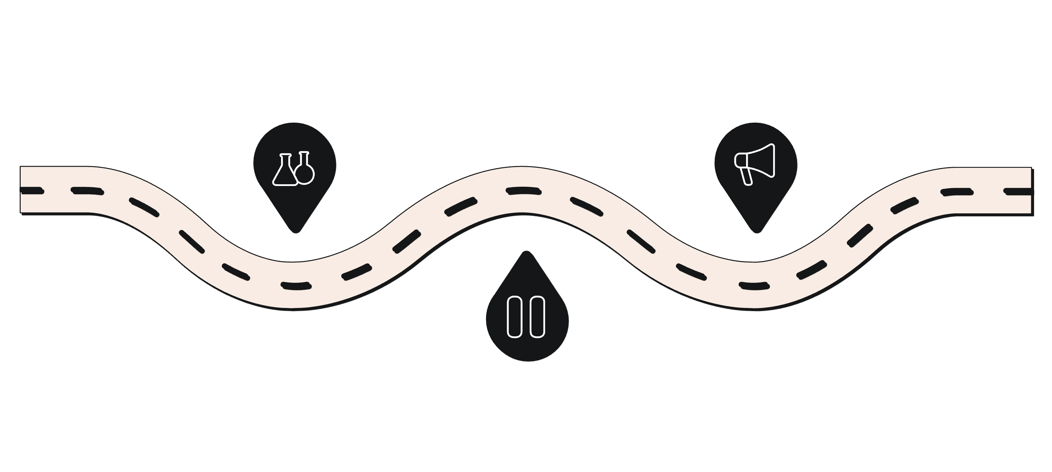



THE TURNING POINT
The Study That Changed Everything — For the Worse
Press Conference
WHI Launch
NIH-funded trial begins in 2002
Women told to stop all hormones BEFORE paper was published!
Premature Halt
Study stopped and results misinterpreted
The Women's Health Initiative (2002) was meant to clarify hormone therapy's safety and prevention of heart disease. Instead, a premature halt and a sensational press conference sent a generation of physicians — and patients — into a fear driven healthcare model.

Slide 8
The Ripple Effect: A Generation of Undertreated Women
Medical Education Gaps
Millions Left Without Relief
The Conversation Was Shut Down
Physicians trained after 2002 learned to avoid hormone therapy as a default — not because of evidence, but because of fear from a flawed press conference.
Women experiencing very real, very treatable symptoms were sent home with nothing — or prescribed antidepressants, sleep aids, muscle relaxers and other workarounds instead.
For over two decades, asking about hormones felt taboo — in the doctor's office and in broader culture. That silence had a cost.

Slide 9

The Retraction Nobody Heard
"All hormones cause cancer." — The headline that shaped a generation of medical practice.
The original statement was later retracted — the data had been misinterpreted. But the correction never made the evening news. No breaking news chyron. No press conference. Just a quiet update that most doctors and patients never saw.
The fear stuck. The fix didn't.

Slide 10
When is HRT the most beneficial?
Timing Hypothesis (10 year window)
  Boomers have been denied during the critical window of prevention without increased risk (plaque destabilization)
  Gen-X is in the critical window of prevention without increased risk
5 year window treatment showed decreased risk
Hormones are great for prevention does not cure!

Slide 11
The WHI proven BENEFITS of HRT:
Increase sleep
Decrease VSM (hot flashes correlate to heart attack)
Decrease GSM
Helps with skin and hair (collagen, blood flow, elastin)
Decreases rate of ALL fractures
Decreases depression and anxiety
Increases bone density
Decreases risk of breast cancer!
Decreases joint pain
Decreases fatty liver and diabetes
Decrease risk Alzheimer's Disease and Dementia
Decreases CVD (#1 cause mortality)
Decreases Colorectal Cancer by 30%
Sexual function
Decreases Macular Degeneration
DECREASED ALL CAUSE MORTALITY AND INCREASED LIFE EXPECTANCY BY 30%
  Statins only increase life expectancy by 9%!

Slide 12

The Black Box Warning
Applied to ALL forms of the drug
  ie: topical, intravaginal, oral
Oral was only form studied in WHI
  Turns out it DID NOT cause cancer!
Actually, decreased risk of breast cancer
  improved survivor outcomes
FDA REMOVED in November 2025

Slide 13
American Urology Association (AUA)
Panel of all specialty experts spent 6 years gathering safety evidence
Looks at TOPICAL estrogen
Safe and effective for increasing bladder turgor, vaginal dryness,
Can be used with oral hormones
Does not go through the liver (First Pass Metabolism, zero increased risk for clots)
Prevents GSM in 50-80% people

Slide 14
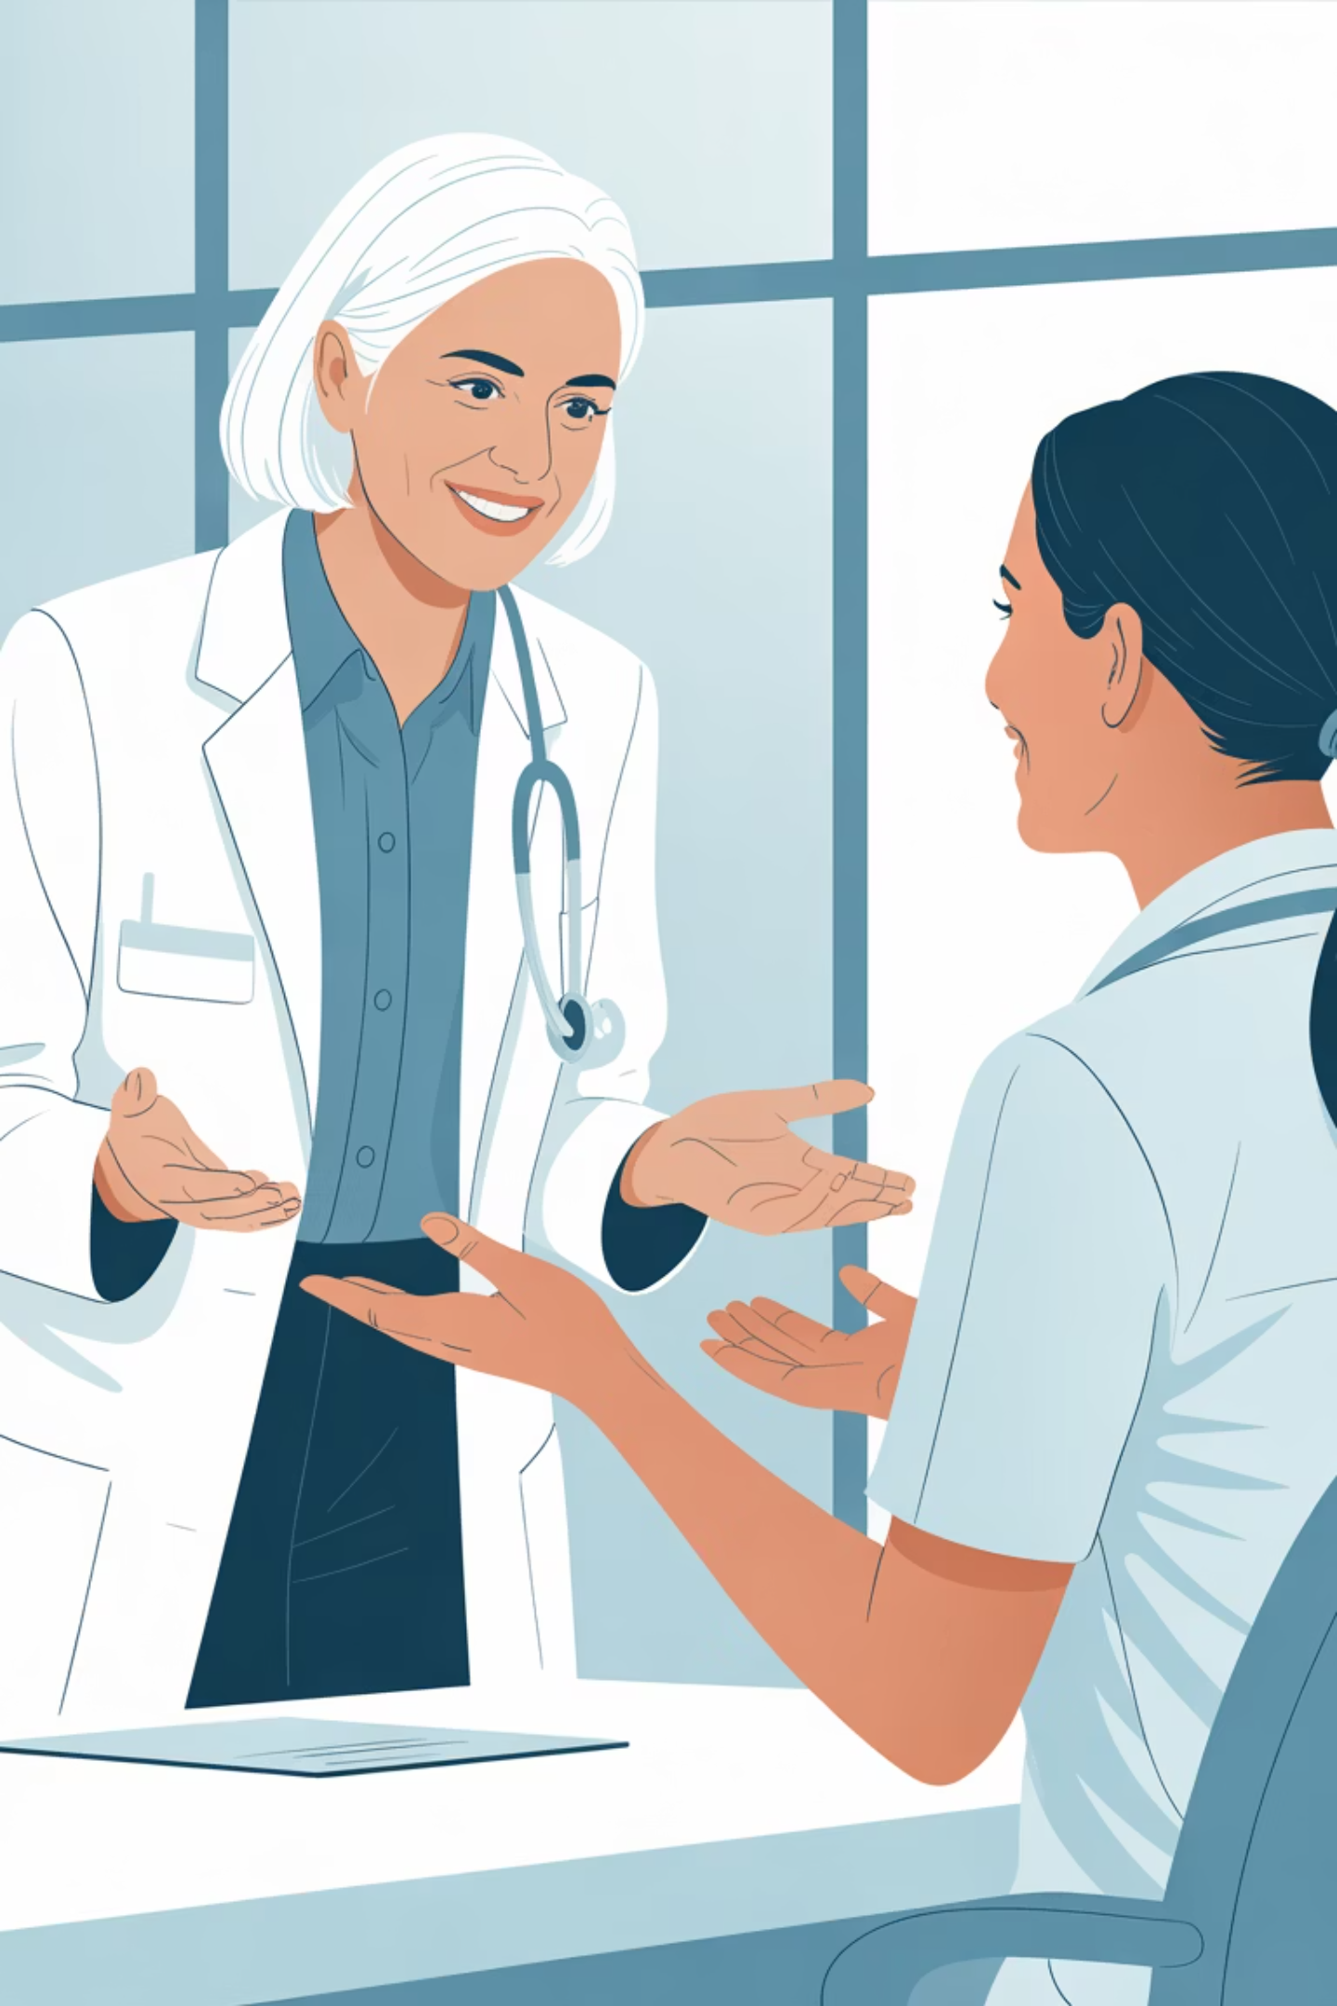



Your Next Step: Start the Conversation
You now know more than most patients — and more than many physicians because they were ever taught. Use that knowledge. Ask the provider what they are afraid of and have the discussion.
Book the Appointment
Bring Your Symptom List
Request a dedicated visit to discuss your hormone health — not just a routine check-in.
Write down every symptom. Be specific. Don't downplay what you're experiencing.
Ask Directly
Ask about estrogen, progesterone, and testosterone — and ask your provider what they know about current evidence. The answer should never be “NO”. There should be a discussion of benefit vs risk and informed consent. A man with erectile disfunction and low energy gets evaluated and given testosterone and sildenafil.

Slide 15
QUESTIONS?

